Slide 1

CS 513 – B
KNOWLEDGE DISCOVERY AND DATA MINING
NEXT-DAY RAIN
PREDICTION IN AUSTRALIA
USING SEVERAL CLASSIFICATION
MODELS

Slide 2

TEAM MEMBERS
ROUSHAN KUMAR
ID : 20009314

Slide 3

INTRODUCTION AND PROBLEM OVERVIEW
Rain plays a vital role in our lives. Clouds are responsible for bringing rain to humans. In order to forecast when it will rain, the weather department tries to do some forecasting.
Agriculture is a major industry in Australia, and rainfall plays a crucial role in determining crop yields. Accurate rainfall predictions can help farmers plan their planting and harvesting activities, and make decisions regarding irrigation and fertilization.
Australia is the driest inhabited continent on earth; 70% of it is either arid or semi arid land, and water is a scarce resource. Predicting rainfall is essential for effective water management, including planning for water storage, allocation, and distribution.
Heavy rainfall can cause flooding in many parts of Australia. Accurate predictions of rainfall can help emergency services and authorities prepare for and respond to potential floods.

Slide 4

OBJECTIVE AND GOAL
Predict
Predict next-day rain using different classification models/ machine learning algorithms /data mining techniques from 10 years of daily weather observations of many locations across Australia.
Classify and predict
Classify and predict possible causes of rain that falls the next day.
Compare
Compare different ML algorithms used for prediction.
Build a predictive model that predicts whether or not it will rain tomorrow in Australia based on their ten years of daily weather observations.
Build

Slide 5
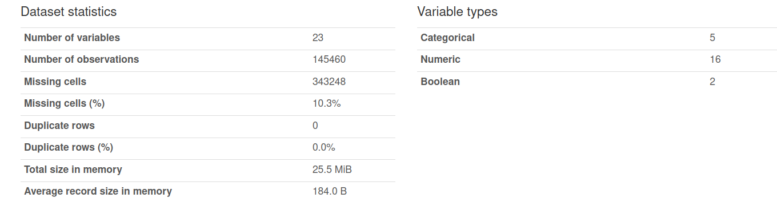
ABOUT THE DATASET
This dataset contains about 10 years of daily weather observations from many locations across Australia.
Data Source References:
https://www.kaggle.com/datasets/jsphyg/weather-dataset-rattle-package

Slide 6
DATA FIELDS
Column Name | Types | Description
Date | Categorical | The date of observation
Location | Categorical | The common name of the location of the weather station
MinTemp | Numeric | The minimum temperature in degrees celsius
MaxTemp | Numeric | The maximum temperature in degrees celsius
Rainfall | Numeric | The amount of rainfall recorded for the day in mm
Evaporation | Numeric | The so-called Class A pan evaporation (mm) in the 24 hours to 9am
Sunshine | Numeric | The number of hours of bright sunshine in the day
WindGusDir | Categorical | The direction of the strongest wind gust in the 24 hours to midnight
WindGustSpeed | Categorical | The speed (km/h) of the strongest wind gust in the 24 hours to midnight
WindDir9am | Categorical | Direction of the wind at 9am
WindDir3pm | Categorical | Direction of the wind at 3pm
WindSpeed9am | Numeric | Wind speed (km/hr) averaged over 10 minutes prior to 9am

Slide 7
Column Name | Type | Description
WindSpeed3pm | Numeric | Wind speed (km/hr) averaged over 10 minutes prior to 3pm
Humidity9am | Numeric | Humidity (percent) at 9am
Humidity3pm | Numeric | Humidity (percent) at 3pm
Pressure9am | Numeric | Atmospheric pressure (hpa) reduced to mean sea level at 9am
Cloud9am | Numeric | Fraction of sky obscured by cloud at 9am. This is measured in "oktas", which are a unit of eigths. It records how many
Cloud3pm | Numeric | Fraction of sky obscured by cloud (in "oktas": eighths) at 3pm. See Cload9am for a description of the values
Temp9am | Numeric | Temperature (degrees C) at 9am
Temp3pm | Numeric | Temperature (degrees C) at 3pm
RainToday | Boolean | Boolean: 1 if precipitation (mm) in the 24 hours to 9am exceeds 1mm, otherwise 0
RainTomorrow | Boolean | The amount of next day rain in mm. Used to create response variable RainTomorrow. A kind of measure of the "risk".
RainTomorrow: It is the target variable to predict next-day rain

Slide 8
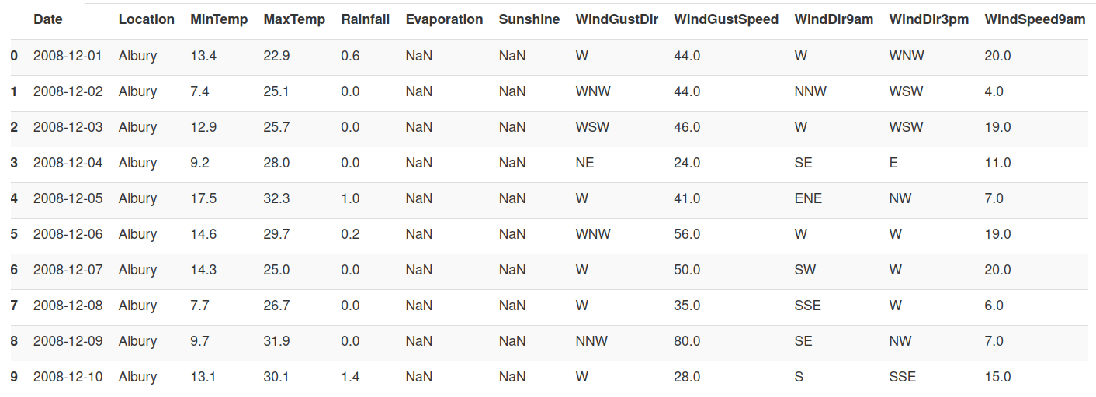
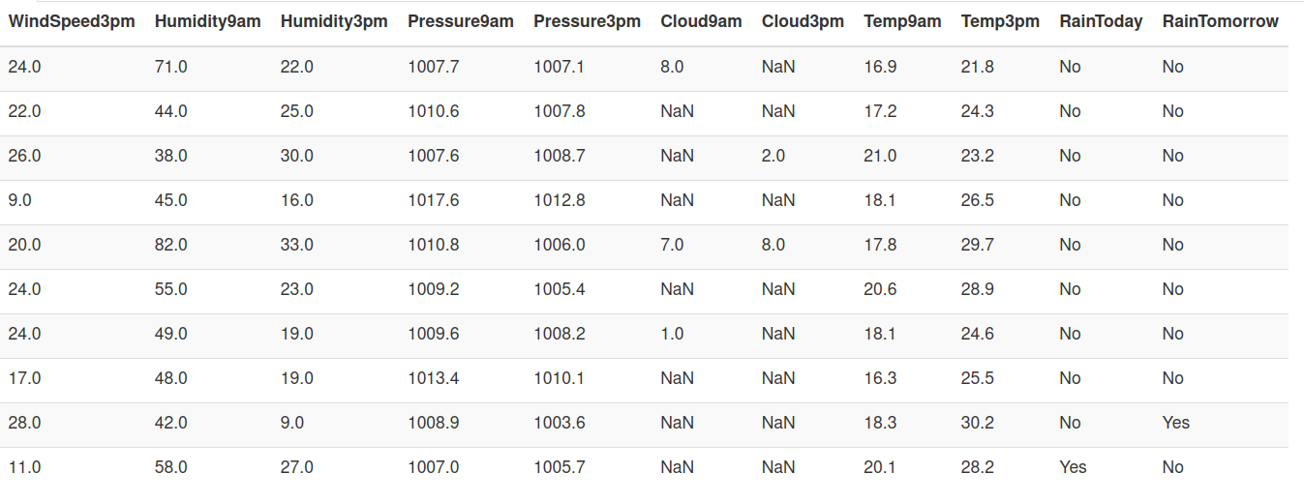
ORIGINAL DATASET

Slide 9
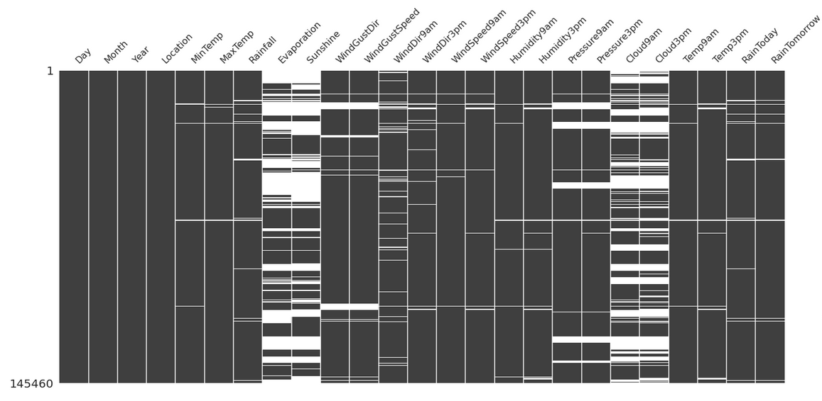
MISSING VALUES

Slide 10
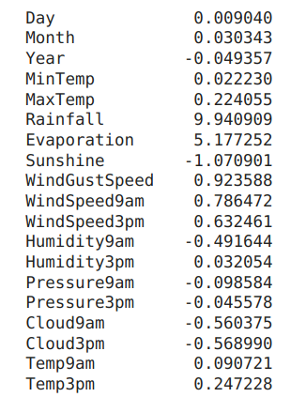
SKEWNESS
Rainfall and Evaporation are highly positively skewed
Sunshine is highly negatively skewed

Slide 11
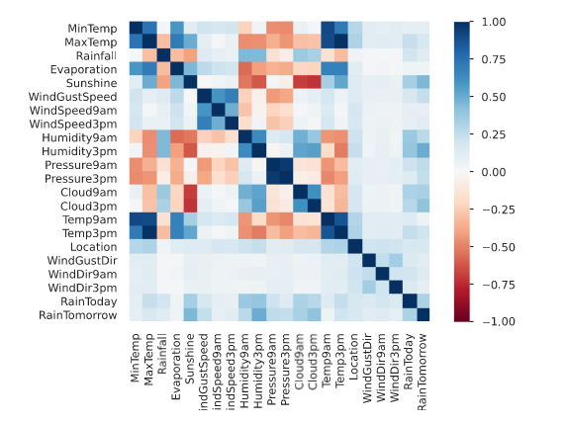
CORRELATIONS HEATMAP

Slide 12
PREPROCESSING
The feature MaxTemp has been removed from the training and testing datasets due to its high correlation with Temp3pm, Temp9am, and MinTemp.
New features for Year, Month, and Day have been included by extracting their values from the original Date column. As a result, the Date feature has been removed from both the training and testing datasets.
Reciprocal transformation was performed on Rainfall and square root transformation was performed on Evaporation because they were highly positively skewed. Additionally, the square of Sunshine was taken because it was highly negatively skewed.
The values of No and Yes in the RainToday and RainTomorrow columns were substituted with 0 and 1 respectively.

Slide 13
PREPROCESSING
The missing values in categorical features (WindGustDir, WindDir9am, WindDir3pm , RainToday and RainTomorrow) were filled by replacing them with the mode value of the corresponding feature.
The missing values in numerical features were filled by replacing them with the median value of the corresponding feature
Target encoding was utilized for the purpose of converting categorical variables of categorical features into numerical variables.
MinMaxScaler was used to normalize features in the dataset.
To address the bais in the training dataset, we utilized the SMOTETomek technique.

Slide 14
MODEL BUILDING
The features [ 'Day', 'Month', 'Year', 'Location', 'MinTemp', 'Rainfall', 'Evaporation', 'Sunshine', 'WindGustDir', 'WindGustSpeed', 'WindDir9am', 'WindDir3pm', 'WindSpeed9am', 'WindSpeed3pm', 'Humidity9am', 'Humidity3pm', 'Pressure9am', 'Pressure3pm', 'Cloud9am', 'Cloud3pm', 'Temp9am', 'Temp3pm', 'RainToday' ]
were used for training the model.
[ 'RainTomorrow' ] is the feature that we aim to predict.
The normalized and imputed data was divided into training and testing datasets in an 80:20 ratio.
To validate the model against the validation dataset, we employed k-fold cross validation.

Slide 15
CLASSIFICATION ALGORITHMS/MODELS
LOGISTIC REGRESSION
NAIVE BAYES
DECISION TREE
RANDOM FOREST
KNEIGHBORS
EXTREME GRADIENT BOOST
SUPPORT VECTOR CLASSIFIER

Slide 16
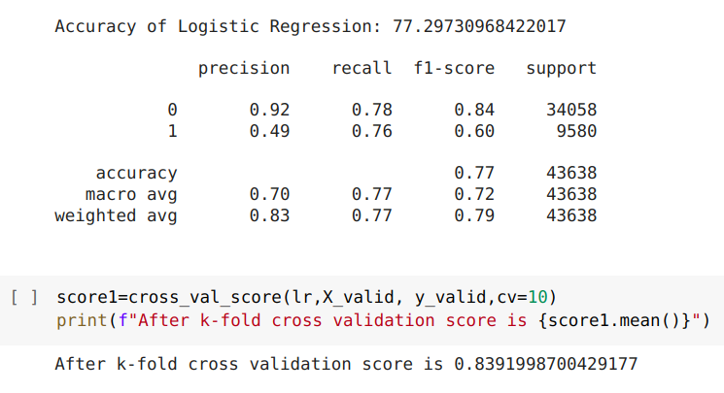
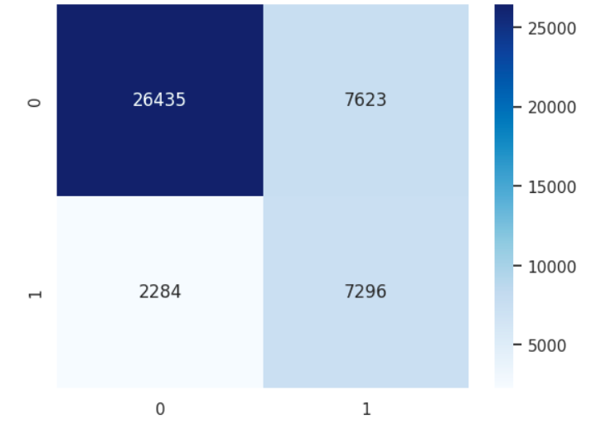
LOGISTIC REGRESSION
Confusion Matrix

Slide 17
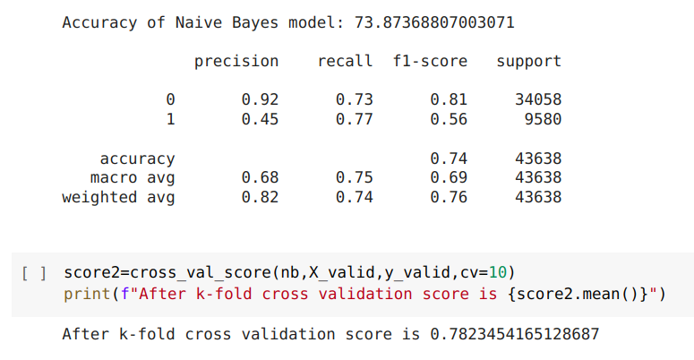
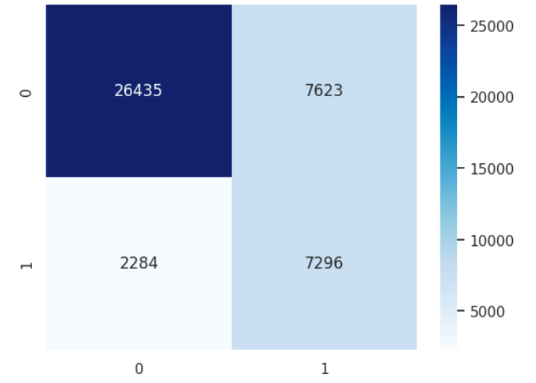
NAIVE BAYES
Confusion Matrix

Slide 18
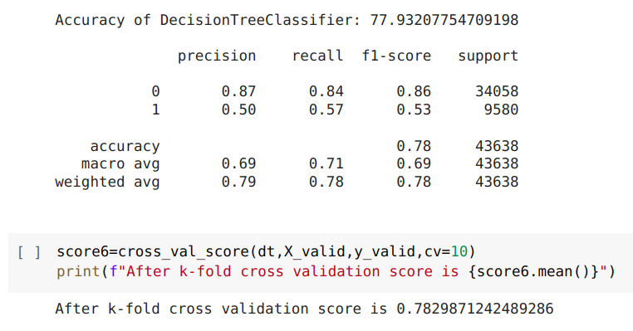
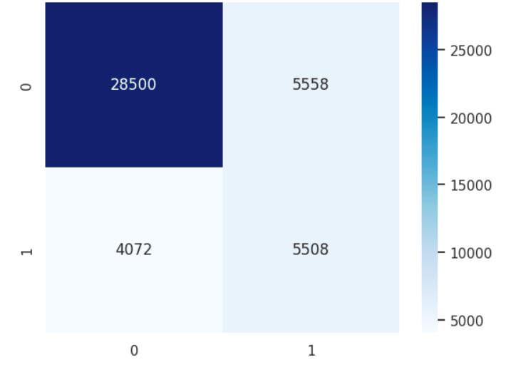
DECISION TREE
Confusion Matrix

Slide 19
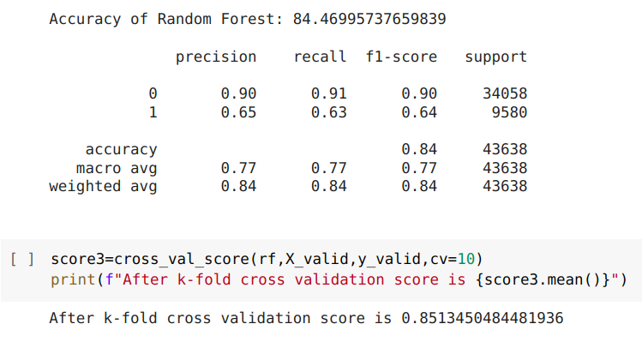
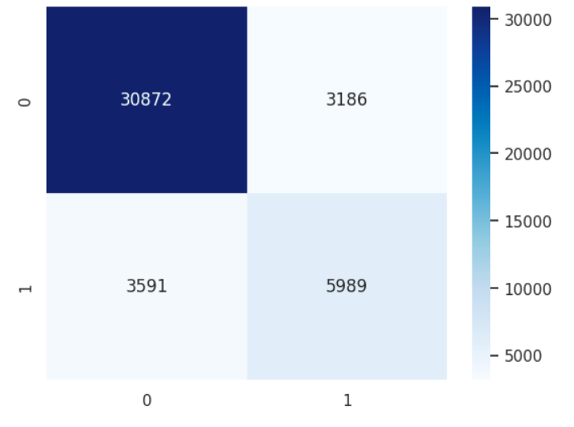
RANDOM FOREST
Confusion Matrix

Slide 20
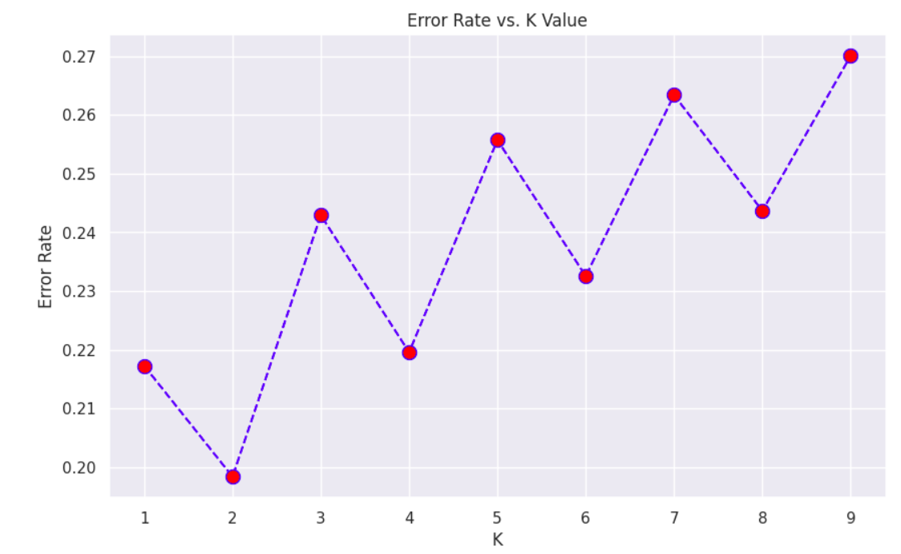
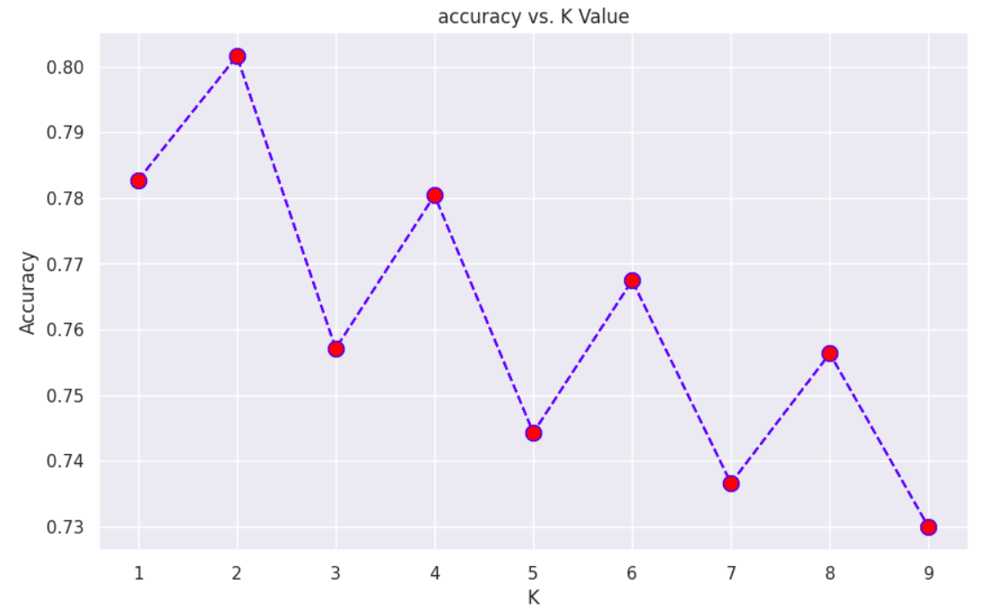
KNEIGHBORS

Slide 21
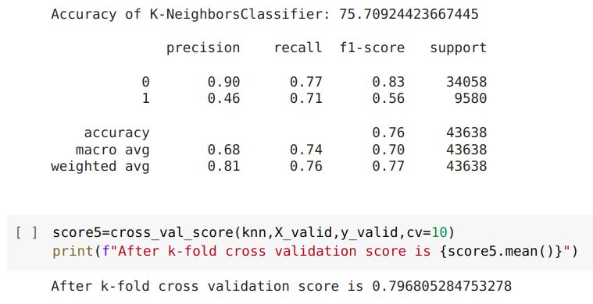
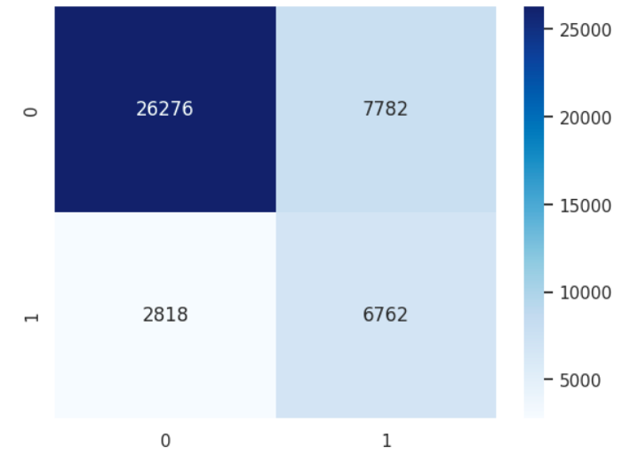
KNEIGHBORS
Confusion Matrix

Slide 22
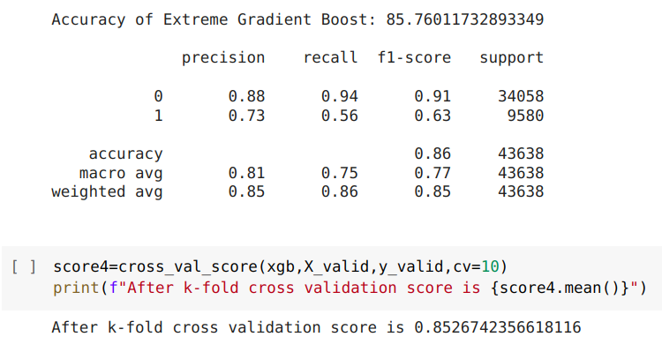
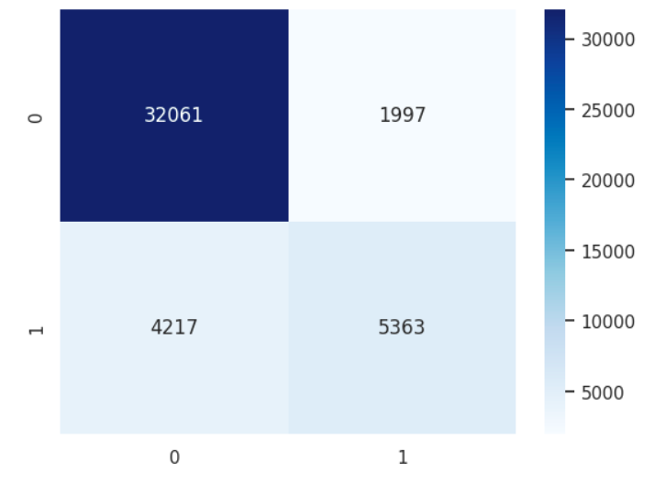
EXTREME GRADIENT BOOST
Confusion Matrix

Slide 23
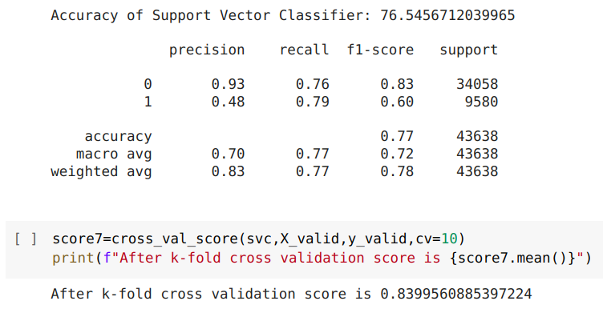
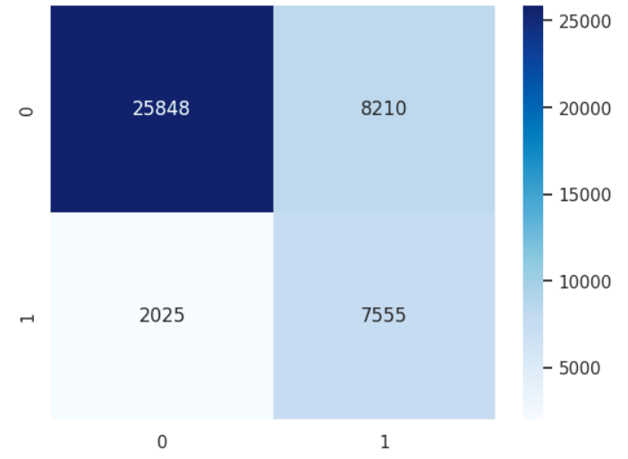
SUPPORT VECTOR CLASSIFIER
Confusion Matrix

Slide 24
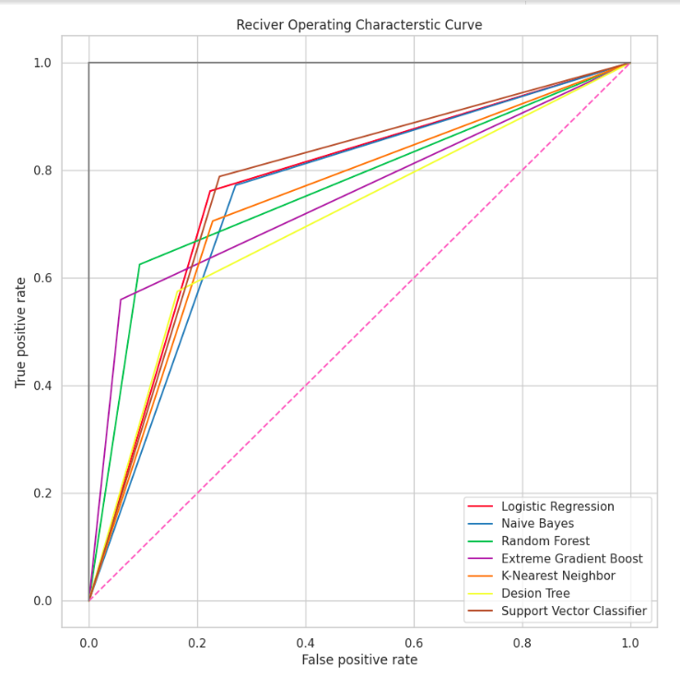
ROC CURVE

Slide 25
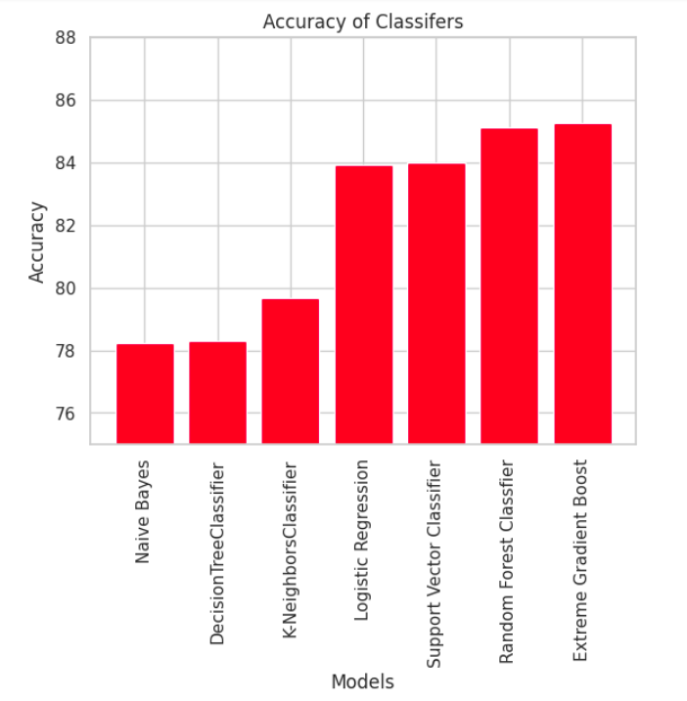
ACCURACY COMPARISON
As we can see,
Extreme Gradient Boost algorithm has highest accuracy for this dataset.

Slide 26
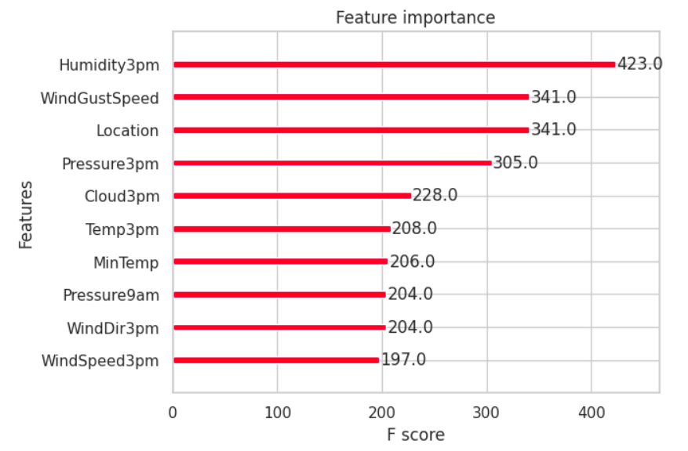
IMPORTANT FEATURES OF EXTREME GRADIENT BOOST CLASSIFIER

Slide 27
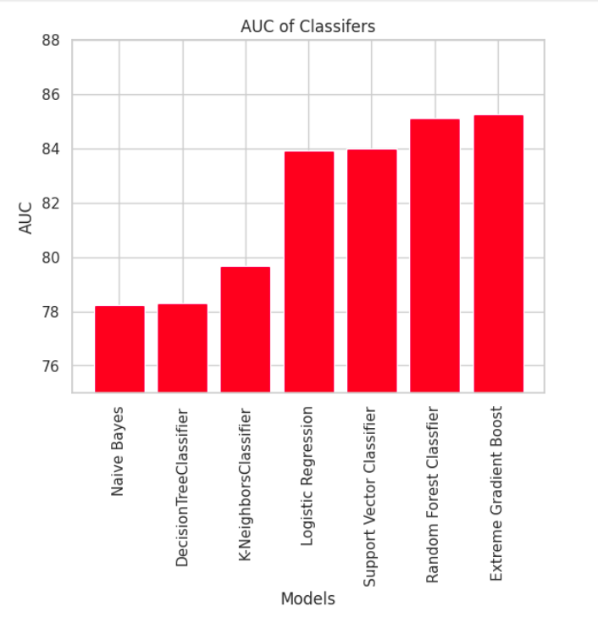
AUC COMPARISON
As we can see,
Extreme Gradient Boost algorithm has most AUC for this dataset.

Slide 28


